Slide 1
Physical Chemistry
Ying Hu
(Fifth edition)
Bilingual Program
版权所有：华东理工大学物理化学教研室

Slide 2
Part II: Rate
Ch. 7 Chemical Kinetics
Bilingual Program
版权所有：华东理工大学物理化学教研室

Slide 3
7. Chemical Kinetics
Framework of the Chapter
  7.1 Introduction
  I. Fundamental Principles of Chemical Kinetics
  7.2 Rates of Chemical Reactions
  7.3 Reaction-Rate Equations
  7.4 Integrated Reaction-Rate Equations
  7.5 Opposite Reactions
  7.6 Consecutive Reactions
  7.7 Parallel Reactions
  7.8 Effect of Temperature on Reaction Rates
  II. Characteristic Parameters in Chemical Kinetics
  7.9 Experimental Methods in Chemical Kinetics
  7.10 Data Processing in Chemical Kinetics
  7.11 Experimental Methods for Rapid Reactions
  7.12 Semi-Empirical Methods
  III. Reaction Mechanisms
  7.13 Reaction Mechanisms and Rate Equations
  7.14 Mono-Molecular Reactions
  7.15 Principles of Microscopic Reversibility and Detailed Equilibrium

Slide 4
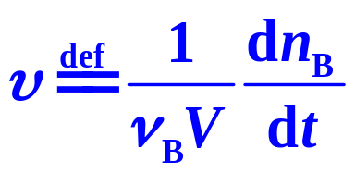
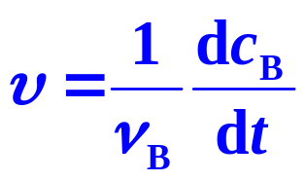
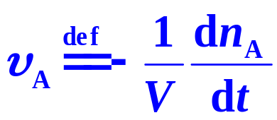
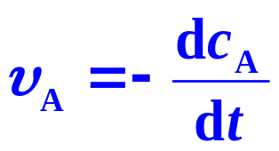
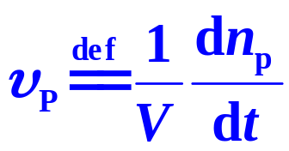
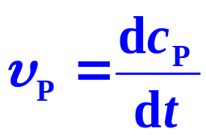
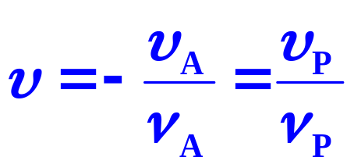
  7.2 Rates of Chemical Reactions
Reaction Rate
Rate of Consumption
(V constant)
Rate of Formation

Slide 5






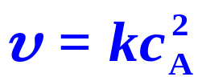
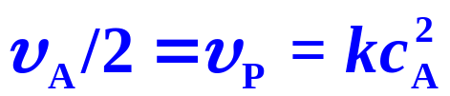


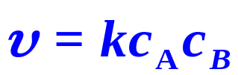


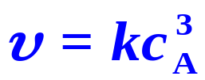
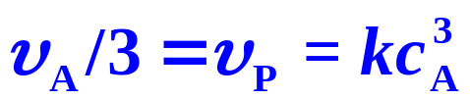



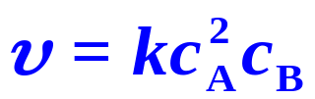
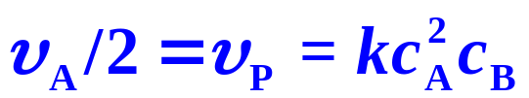


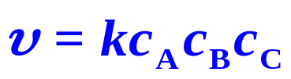
  7.3 Reaction-Rate Equations
1. Elementary Reactions
Consumption (Formation) Rate
Reaction type
Reaction rate
Unimolecular Reactions
Bimolecular Reactions
Trimolecular Reactions

Slide 6
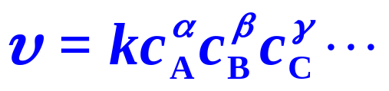
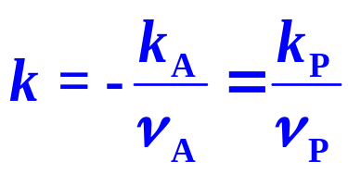
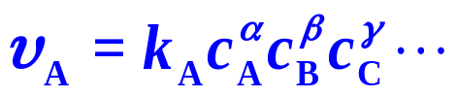
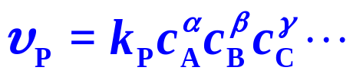
  7.3 Reaction-Rate Equations
2. Complex Reactions
(1) Rate Equations of Power-Function Type
k — Rate Constant,
α, β, γ , — Partial Orders,
n = α + β + γ +… , — Reaction Orders,

Slide 7
7. Chemical Kinetics
  I. Fundamental Principles of Chemical Kinetics
  7.2 Rates of Chemical Reactions
  7.3 Reaction-Rate Equations
  7.4 Integrated Reaction-Rate Equations
  7.5 Opposite Reactions
  7.6 Consecutive Reactions
  7.7 Parallel Reactions
  7.8 Effect of Temperature on Reaction Rates

Slide 8
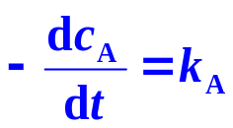

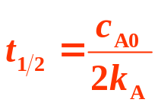


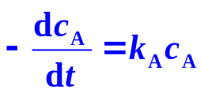
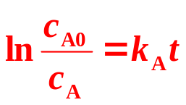

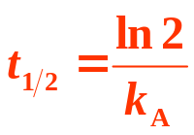

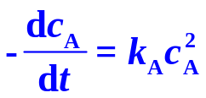
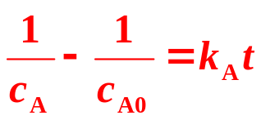
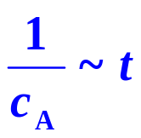
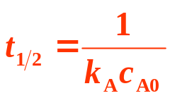

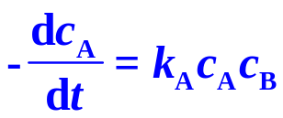
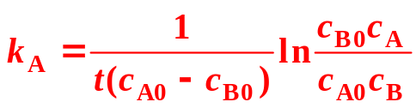
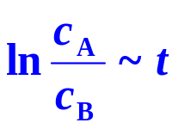
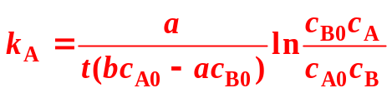
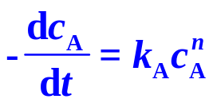
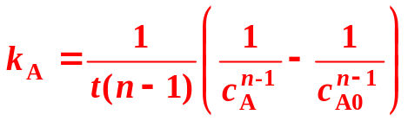

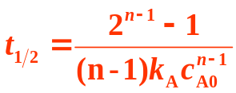

Summary
aA＋bB →P
Order | Rate equation |  | Characteristics
 | Differential | Integrated | Linear plotting | k_{A} Dimension | Half life t_{1/2}
0
n_{A}=1, n_{B}=0
n_{A}=2, n_{B}=0
n_{A}=1, n_{B}=1 a=b,c_{A0}≠c_{B0}
n_{A}=1, n_{B}=1 a ≠ b,c_{A0}≠c_{B0}
n

Slide 9
7. Chemical Kinetics
  I. Fundamental Principles of Chemical Kinetics
  7.2 Rates of Chemical Reactions
  7.3 Reaction-Rate Equations
  7.4 Integrated Reaction-Rate Equations
  7.5 Opposite Reactions
  7.6 Consecutive Reactions
  7.7 Parallel Reactions
  7.8 Effect of Temperature on Reaction Rates

Slide 10
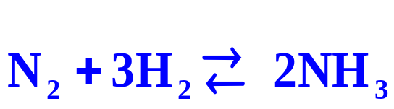
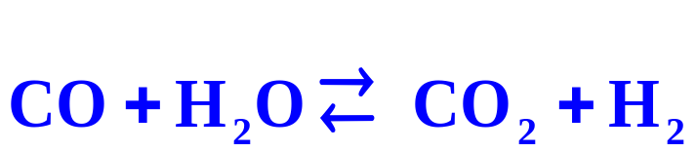
  7.5 Opposite Reactions
  Opposite Reactions
When a reaction is the reverse to another reaction, the combination of the two reactions is called an opposite reaction.
In principle, all reactions are opposite reactions, only on some occasions, the reverse reaction is so slow that can be neglected.

Slide 11
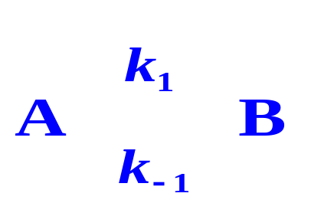


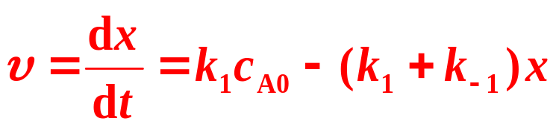

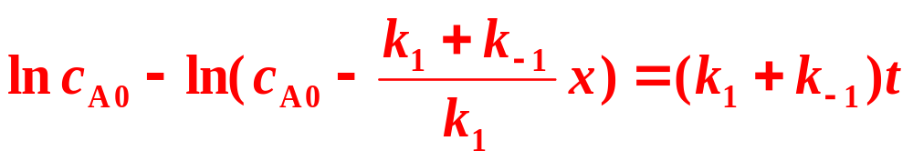
  7.5 Opposite Reactions
First Order Opposite Reactions
t=0，c_{A}=c_{A0}，c_{B0}=0； t=t，c_{A}=c_{A0}-x，c_{B}=x.
Rate Equation
Integrated Rate Equation

Slide 12
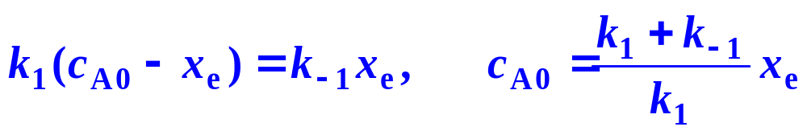
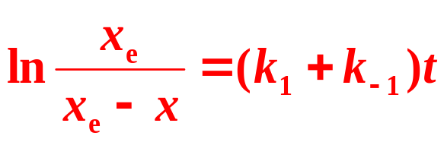
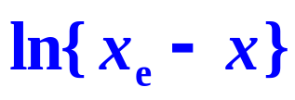
  7.5 Opposite Reactions
Integrated Rate Equation
At equilibrium, c_{B} = x_{e}, c_{A}=c_{A0}−x_{e},
Characteristics
against t shows a linear relation
The time needed for consuming x_{e}/2 of the concentration of the reactant A is ln2/(k₁+k₋₁)

Slide 13
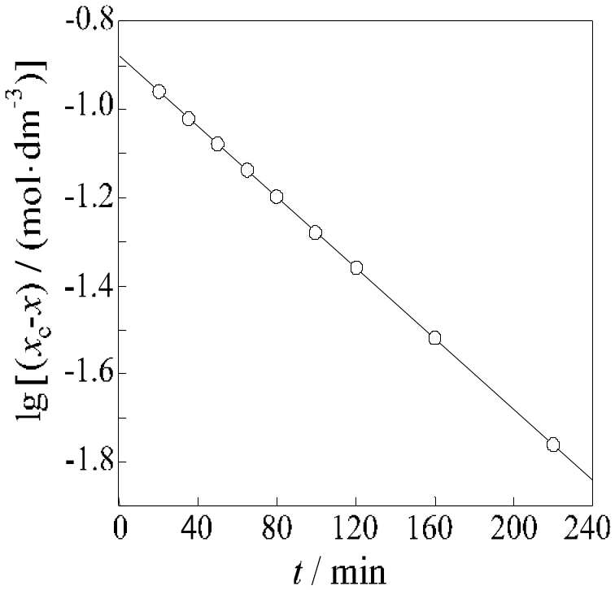
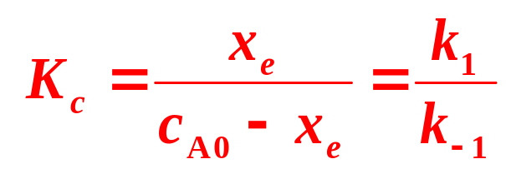
  7.5 Opposite Reactions
Plots lg{x_{e}−x} against t showing a straight line, from the slope of the line, we can calculate k₁+k₋₁.
Plots lg{x_{e}−x} against t showing a straight line, from the slope of the line, we can calculate k₁+k₋₁.
Equilibrium Constant K_{c}
k₁, k₋₁
k₁, k₋₁
Notes:
Opposite reaction的最简积分方程中xe为平衡时的转化浓度。这种表达可以看做是AB对峙反应从平衡经一级反应推回到A的过程，只是这个t是从B浓度为0开始计时的。一级对峙反应，连续反应的求解都是伯努利方程形式，要会用已学过的知识求解，当然在物化上重在理解它的含义。

Slide 14
7. Chemical Kinetics
  I. Fundamental Principles of Chemical Kinetics
  7.2 Rates of Chemical Reactions
  7.3 Reaction-Rate Equations
  7.4 Integrated Reaction-Rate Equations
  7.5 Opposite Reactions
  7.6 Consecutive Reactions
  7.7 Parallel Reactions
  7.8 Effect of Temperature on Reaction Rates

Slide 15
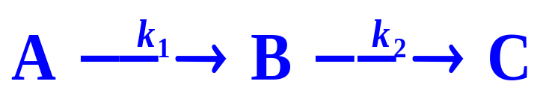
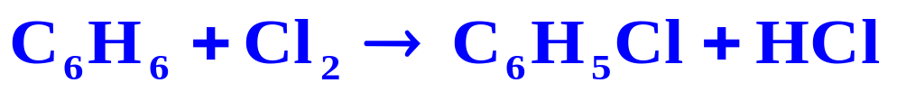
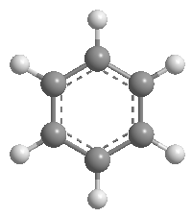
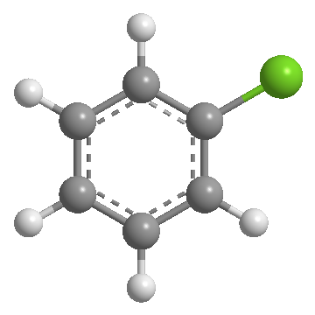
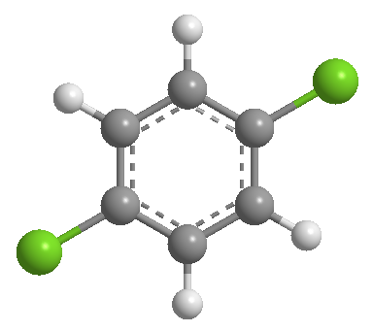

  7.6 Consecutive Reactions
When a certain product of a reaction is a reactant of another reaction (the later is not the reverse reaction of the former), the combination of these reactions is called a consecutive reaction.
Cl₂
Cl₂
Cl₂

Slide 16








  7.6 Consecutive Reactions
First Order Consecutive Reactions
Both the reactions 1 and 2 are the first order
When t=0, c_{A} = c_{A0}, c_{B0} = c_{C0} =0.
Rate Equations
Integrated Rate Equations

Slide 17





  7.6 Consecutive Reactions
Characteristics
Variations of c_{A}, c_{B} and c_{C} with time for a first order consecutive reaction.
Remarkable property:
An appearance of a maximum of the c_{B}

Slide 18




  7.6 Consecutive Reactions
The maximum c_{B}, and the corresponding maximum time t_{max}
At the maximum,
c_{B} ₌ c_{B,max}, dc_{B}/dt=0, t=t_{max},
k₁,k₂
Notes:
由数学方法易证：tm和Cb,m,均随k1/k2的增加单调递增，这和化学直觉完全一致，即：A—B的反应速率快而B—C的反应速率偏慢时，B是可持续存在的中间产物，而反之，则B不能以较高浓度持续存在。且A—B/B—C反应速率常数的比例增大时tm和Cm均会增加。

Slide 19




  7.6 Consecutive Reactions
Stable and Unstable Intermediates
When k₁/k₂ is larger
When k₁/k₂ is smaller
Stable Intermediates
Unstable Intermediates
For the unstable intermediate, B is at a steady state

Slide 20
7. Chemical Kinetics
  I. Fundamental Principles of Chemical Kinetics
  7.2 Rates of Chemical Reactions
  7.3 Reaction-Rate Equations
  7.4 Integrated Reaction-Rate Equations
  7.5 Opposite Reactions
  7.6 Consecutive Reactions
  7.7 Parallel Reactions
  7.8 Effect of Temperature on Reaction Rates

Slide 21

  7.7 Parallel Reactions
When the reactants participate in two or more reactions independently and simultaneously, the combination of these reactions is called a parallel reaction.
Nitration of toluene forms ortho-, meta- and para-nitrotoluene

Slide 22







  7.7 Parallel Reactions
First Order Parallel Reactions
When t=0, c_{A} = c_{A0}, c_{B0}=c_{C0}=0.
Rate Equations
Integrated Rate Equations

Slide 23




  7.7 Parallel Reactions
Characteristics
The ratio of the product concentrations is the same as the ratio of the reaction constants
The determination of reaction constants
Rate equation
k₁, k₂
Ratio of concentrations

Slide 24




  7.7 Parallel Reactions
Parallel Reactions with Other Orders
The concentrations of the three products keep as the constants
ortho- 58.5％, meta- 4.4％, para-nitrotoluene 36.8％

Slide 25
7. Chemical Kinetics
  I. Fundamental Principles of Chemical Kinetics
  7.2 Rates of Chemical Reactions
  7.3 Reaction-Rate Equations
  7.4 Integrated Reaction-Rate Equations
  7.5 Opposite Reactions
  7.6 Consecutive Reactions
  7.7 Parallel Reactions
  7.8 Effect of Temperature on Reaction Rates

Slide 26






  7.8 Effect of Temperature on Reaction Rates
Works in Earlier Stage by Van′t Hoff et al
Temperature influence to the reaction rates is mainly
by changing the rate constants or coefficients
Van't Hoff rule (1884)
Berthelot (1862)
Kooij (1893)
Harcourt and Esson (1895)

Slide 27
  7.8 Effect of Temperature on Reaction Rates
Concept of Activated Molecules
In 1889, Arrhenius proposed that only the molecules with activation energy Ea can participate in the reaction. The reason of the increase of reaction rate with rising temperature is because of the increase of the number of the activated molecules.
Arrhenius Equation
k— Reaction rate constant
Ea— activation energy
A— pre-exponential factor
e^{-Ea/(RT)} — Boltzmann factor

Slide 28



  7.8 Effect of Temperature on Reaction Rates
Arrhenius Activation Energy
Physical meaning: The difference between the average molar energy of the activated molecules of reactants and that of the total reactant molecules.
The larger Ea, the more serious temperature effect, the reaction rate will accelerate more notably when raising temperature.

Slide 29


  7.8 Effect of Temperature on Reaction Rates
Arrhenius Activation Energy
If Ea can be treated as a constant in the temperature range,
Plotting ln{k} against 1/T should give a straight line with a slope of −Ea/R and an intercept of ln{A}
If Ea is temperature dependent in the temperature range,

Slide 30


  7.8 Effect of Temperature on Reaction Rates
Various Types of the Temperature Dependence of the Reaction Rate Coefficients
Common reactions
Explosion
Enzyme reactions
Very rare
Generalized Rate Equations

Slide 31





  7.8 Effect of Temperature on Reaction Rates
Example
Experimental data of at different temperatures are listed in Table, Calculate E_{a} and A.
ln{k}~1/(T/K) plot showing a straight line with a slope of −12.40×10³ and an intercept of 31.36.

